Slide 1
Exploring Network Security with Python and Nmap
By: Nicholas Fisher

Slide 2
Objectives
Learn about Network Reconnaissance:
Understand the importance of gathering information about a target network and how it aids in identifying vulnerabilities.
Introduction to Ethical Hacking:
Explore the concept of ethical hacking and how it differs from malicious hacking.
Python and Nmap:
Gain insights into Python packages and tools like Nmap used in ethical hacking practices.

Slide 3

Link to our Course GitHub
Github : https://github.com/FishyStix12/BH.py-CharCyCon2024/tree/main

Slide 4

What is Network Reconnaissance?
Definition:
Network reconnaissance involves actively gathering information about a target network to understand its structure, services, and potential vulnerabilities.
Importance:
It allows security professionals to assess the security posture of a network and identify potential entry points for attackers.
Techniques:
Network reconnaissance techniques include port scanning, banner grabbing, packet sniffing, and vulnerability scanning.

Slide 5

Introduction to Nmap
Overview:
Nmap, short for Network Mapper, is a widely-used open-source tool for network exploration and security auditing.
Features:
Nmap offers features such as port scanning, service version detection, OS detection, and scripting capabilities, making it a versatile tool for network analysis.
Applications:
It is used by network administrators, security professionals, and ethical hackers for network troubleshooting, vulnerability assessment, and penetration testing.

Slide 6

Understanding the Python Nmap Script net_terrorizer.py
Description of this Script:
The provided script is a tool designed for ethical hacking purposes, focusing on network reconnaissance and vulnerability assessment. It leverages the python-nmap library and other Python packages to automate comprehensive scans on remote hosts.

Slide 7
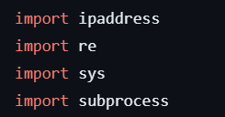
Python Libraries Used
ipaddress:
Purpose: Provides classes to represent and manipulate IP addresses and networks.
Usage: Used for parsing and validating IP addresses and CIDR notations in the script.
re (Regular Expression):
Purpose: Provides support for regular expressions (RE).
Usage: Employed for pattern matching and extraction of CVEs and Metasploit modules from Nmap scan results.
sys:
Purpose: Provides access to some variables used or maintained by the Python interpreter and to functions that interact strongly with the interpreter.
Usage: Utilized for handling script exit conditions and printing error messages.
subprocess:
Purpose: Allows the creation of new processes, connects to their input/output/error pipes, and obtains their return codes.
Usage: Used to execute Nmap commands from within the Python script and capture their output.

Slide 8
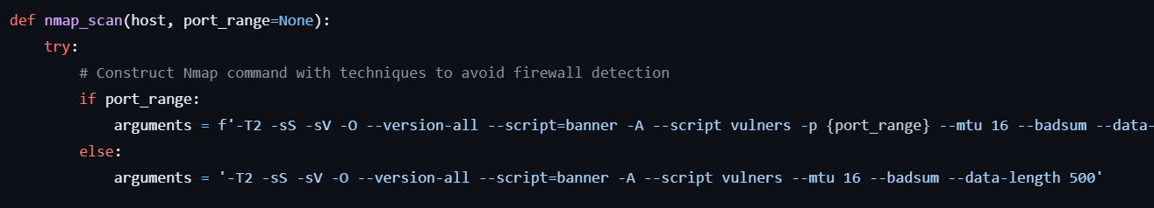
Nmap Scan Function Overview
Function Name: nmap_scan
Purpose: Conducts Nmap scans on specified hosts with options to evade firewall detection and extract vulnerability information.
Key Features:
Constructs Nmap command with customizable options.
Utilizes subprocess module to execute Nmap commands.
Extracts CVEs and Metasploit modules from scan results using regular expressions.

Slide 9
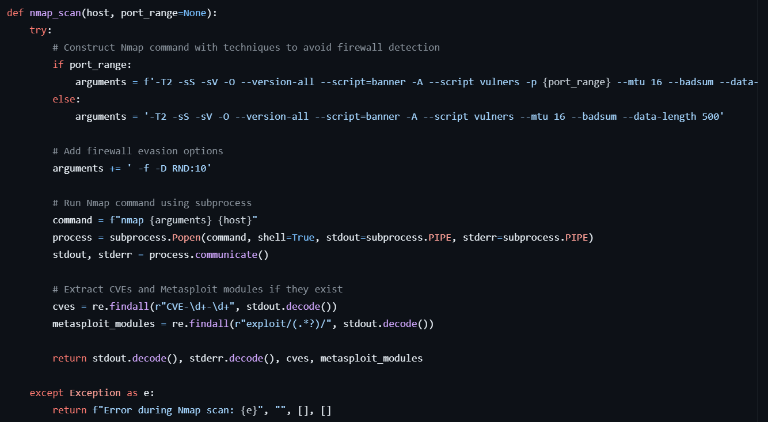
Nmap Scan Function Details
Arguments:
host: Target host IP address or hostname.
port_range (optional): Range of ports to scan (default is None for full scan).
Nmap Command Construction:
Dynamically constructs Nmap command based on provided arguments and evasion techniques.
Incorporates options for timing, service detection, operating system detection, script scanning, and firewall evasion.
Error Handling:
Catches exceptions during the Nmap scan process and returns informative error messages.
Output:
Returns scan output (stdout), error messages (stderr), CVEs, and Metasploit modules found during the scan.

Slide 10
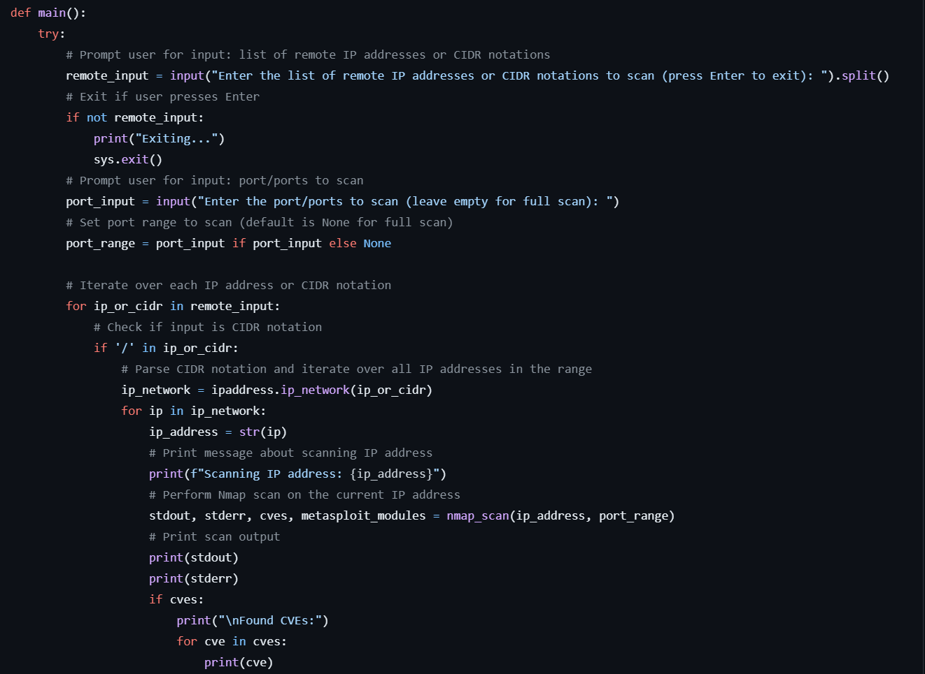
Main Function Overview
Function Name: ‘main’
Purpose:
Facilitates user interaction, input validation, and orchestration of Nmap scans for remote IP addresses or CIDR notations.
Key Features:
Prompts users for input: list of remote IP addresses/CIDR notations and ports to scan.
Handles user exit if no input is provided.
Iterates over each provided IP address or CIDR notation, performs Nmap scans, and prints scan results.

Slide 11
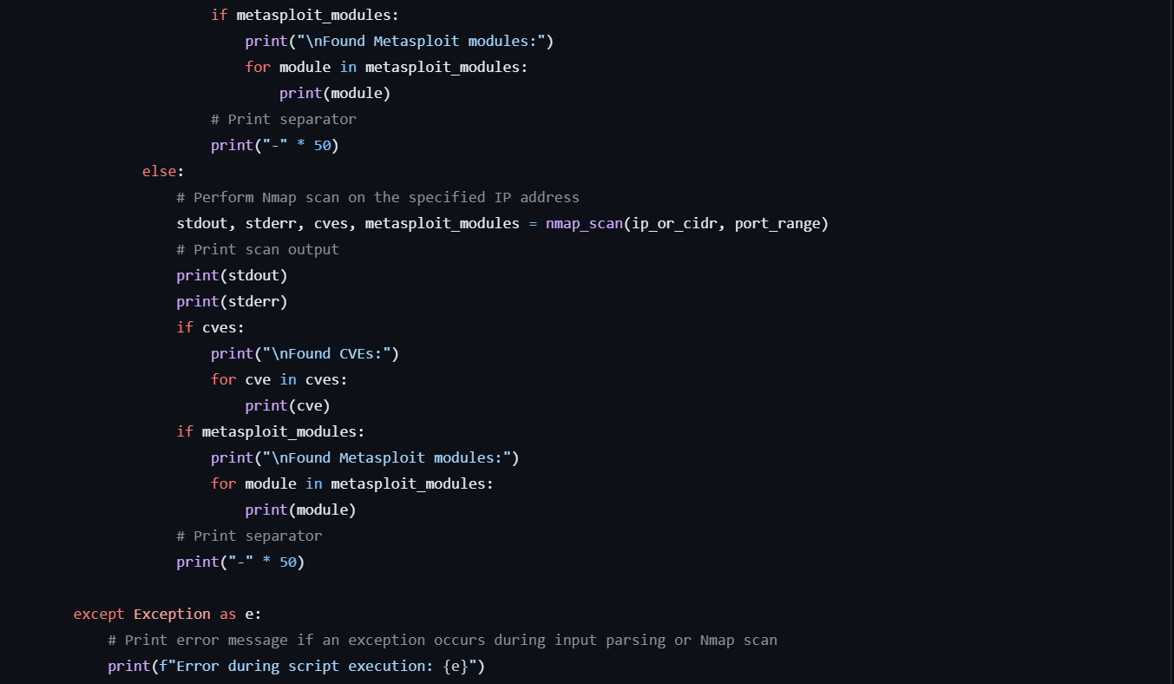
Main Function Execution Flow
User Interaction:
Prompts user for input of IP addresses/CIDR notations and port/ports to scan.
Validates and processes user input for conducting Nmap scans.
Nmap Scan Iteration:
Iterates over each IP address or CIDR notation provided by the user.
Conducts Nmap scans using the nmap_scan function.
Output Handling:
Prints scan output, including CVEs and Metasploit modules found, if any.
Error Handling:
Catches and prints error messages if exceptions occur during input parsing or Nmap scan execution.

Slide 12

Script Execution
Script Execution Control:
Utilizes the __name__ attribute to control script execution.
Checks if the script is being run directly as the main program.
Main Function Call:
Initiates the execution of the main() function if the script is run as the main program.
Purpose:
Ensures modular and organized script structure by separating function definitions from script execution.
Flexibility:
Allows the script to be imported as a module into other Python programs without executing the main functionality automatically.

Slide 13
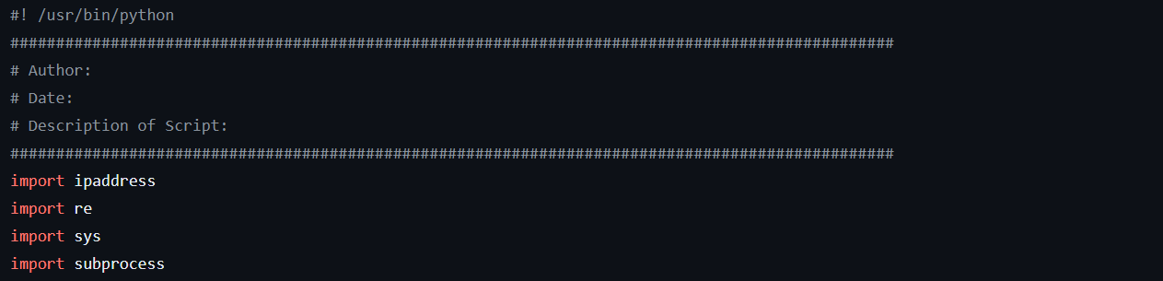
Introduction to yourTurn.py
Author: [Provide space for the author's name]
Date: [Provide space for the date of creation]
Description of Script:
Starter script for students to develop their own Python Nmap tools.
Provides a foundation for conducting Nmap scans with customizable options.
Encourages students to complete the script by adding their own functionalities.

Slide 14
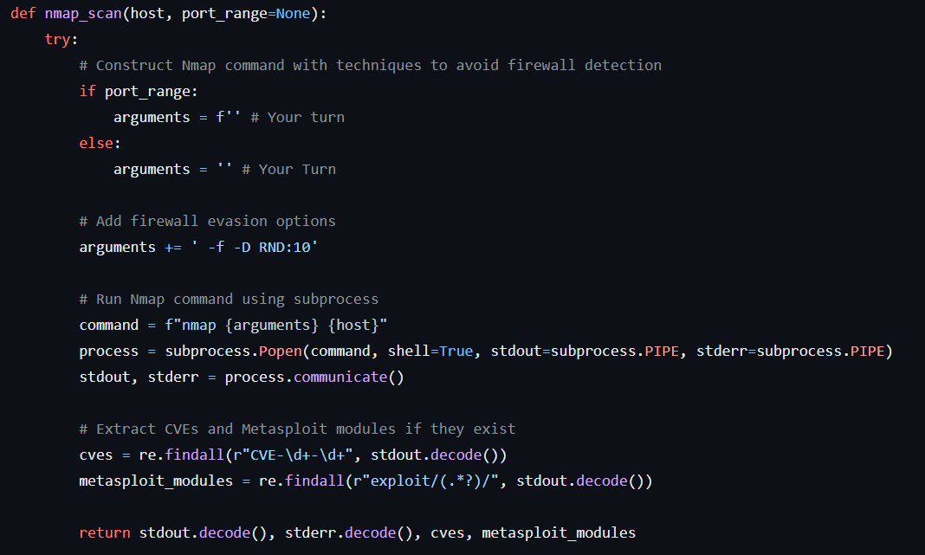
Script Development Instructions
Completion Task:
Students are tasked with completing the script by adding their own functionalities below the provided code.
Guidelines:
Encourage students to enhance the script by incorporating additional Nmap scan options.
Prompt students to implement features such as output formatting, error handling, or integration with other security tools.
Learning Objectives:
Fosters understanding of Nmap usage and Python scripting.
Promotes creativity and problem-solving skills in developing cybersecurity tools.

Slide 15

Script Development Framework
Script Structure:
Provide space for students to add their own code below the existing function.
Suggestions for Enhancement:
Encourage students to document their code with comments for clarity.
Recommend testing their additions thoroughly to ensure functionality and reliability.
Resources:
Offer references to Nmap documentation and Python programming resources for further exploration and learning.

Slide 16

Questions?

Slide 17

Conclusion
Key Takeaways:
Nmap Vulnerability Scans offer comprehensive network security insights.
Proactive vulnerability assessment aids in identifying and mitigating risks.
Continuous learning and vigilance are crucial for effective cybersecurity measures.
Thank you!

